Slide 1
Modern web development with ASP.NET Core & Blazor in .NET 9
Daniel Roth
Principal Product Manager
Microsoft

Slide 2
ASP.NET Core: Your full stack web platform for .NET
Web UI
APIs
Data
Server
Security
Tooling
Notes:
ASP.NET Core is your full stack web platform for .NET, providing everything you need to build modern web apps and scalable backend services. Whether you're building a beautiful Blazor UI with or scalable backend services, ASP.NET Core gives you everything in a single framework, including high-performance servers, built-in security features, and excellent tooling.

Slide 3

ASP.NET Core in .NET 9
Quality &
fundamentals
Developer
experience
Cloud native
Notes:
ASP.NET Core in .NET 9 is loaded with new features and improvements.
First and foremost, the team has been focused on quality and fundamentals. This includes extensive work on performance, accessibility, and security. ASP.NET Core in .NET 9 is built to help ensure that your apps are secure by default and are ready to handle even the most demanding workloads.
We've also added a bunch of improvements to provide the best web development experience possible, including built-in OpenAPI support, lots of Blazor enhancements, and improved tooling & debugging.
And when you then want to publish your ASP.NET Core app to the cloud, it's ready to go thanks to expanded support for ahead-of-time compilation, as well as improved monitoring & tracing.

Slide 4

The fastest ASP.NET Core yet!
15% throughput*
93% memory usage on high core-count machines*
25% startup time for Blazor WebAssembly**
WebSocket message compression for Blazor Server
Precompression and improved caching for static web assets
* TechEmpower JSON Min APIs, Intel Gold 56 cores (logical) Linux
** Lighthouse
Notes:
This is the fastest release of ASP.NET Core yet, providing industry leading performance.
You get higher throughput while using significantly less memory thanks to Adaptive Garbage Collection (GC).
Blazor WebAssembly apps startup much faster, and Blazor Server apps are more responsive thanks to WebSocket message compression.
And all your static web assets are now automatically optimized with precompression and fingerprinting, so that they can be efficiently downloaded and cached.
Let's take a look at some of these new features. Dan, do you want to show us what's new for the frontend?

Slide 5

OPTION 1
Powerful tools, templates, and packages for building observable, production-ready apps
Streamlined Inner-Loop
Developer Dashboard
Integrations
Deployment
OpenTelemetry built-in, YAML-free, multi-cloud, and extensible
dot.net/aspire
Notes:
.NET Aspire is a collection of flexible tools, opinionated templates, and curated packages for modern developers. Aspire simplifies managing projects, resources, containers, microservices, and more – at development time while you write code.
Plus, Aspire gives you real-time insights into your app while you’re actively developing it – no more pushing to staging environments or production to see how your changes play with the rest of your stack.
We’ve worked with a bunch of popular cloud library and service authors to create integrations that simplify setting up and managing all of the various resources we need to build production apps at scale, and to help you build secure-by-default apps in a world where cyberattacks just don’t stop.
We’ve also worked with teams in Azure and AWS to simplify basic deployments to get your apps up and running, and your fixes shipped to your customers, faster than ever.

Slide 6
Demo
ASP.NET Core + Aspire = 😍
Notes:
Start with a Blazor Web App that calls an API

Slide 7
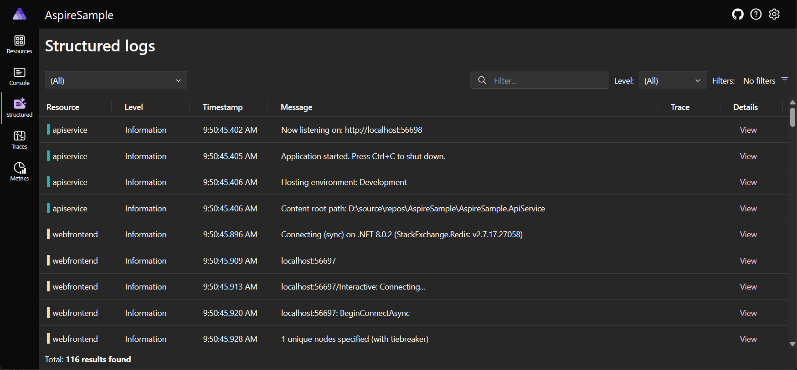
.NET Aspire dashboard – built with Blazor
Fluent UI Blazor components: aka.ms/blazor/fluentui

Slide 8
Blazor improvements
Detect the component render mode at runtime
Improved reconnection logic
Use static SSR in a globally interactive app
Simplified Blazor authentication state serialization
Component constructor injection
Blazor Hybrid + Web project template

Slide 9
Demo
Blazor improvements
Notes:
Detect render mode at runtime
Improved reconnection experience

Slide 10


LEAF from Aspen
AI-powered learning for law students built with Blazor, .NET MAUI, & Azure AI
Overall, amazing experience! I have people that have never touched mobile apps, never touched web apps, but are now able to use .NET MAUI & Blazor to develop delightful mobile & web experiences.
Hassan Habib, Director of Engineering, Aspen Publishing
https://aspenpublishing.com/pages/leaf-from-aspen
Notes:
Aspen Publishing uses Blazor to build their new LEAF learning app. With a small ambitious team, they were able to deliver web, mobile, and desktop experiences that give law students access to Aspen’s extensive learning library. They used Azure AI speech synthesis to generate smooth natural sounding narration so that students can immerse themselves in a dynamic learning environment while on the go. By using .NET as a common platform, they were able to more easily onboard developers onto the project and help them get productive fast.

Slide 11
Optimized static web assets
Precompression: Precompress all uncompressed static assets.
Fingerprinting: Add unique hashes to file names on publish.
Caching: Serve static web assets once and avoid servicing stale assets.
Endpoint routing: Surface static assets as endpoints to support endpoint aware features (authorization, etc.)

Slide 12
Demo
Static web assets

Slide 13
Built-in OpenAPI support
OpenAPI document generation for minimal and controller-based APIs
Runtime & build-time document generation
Customize document generation via transformers
Works with existing testing UIs and libraries
Native AOT-compatible

Slide 14
Demo
OpenAPI

Slide 15
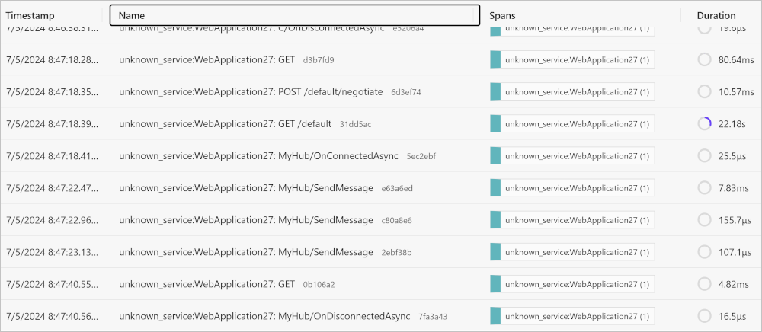
SignalR improvements
Native AOT support
Polymorphic type support
Improved activity tracing

Slide 16
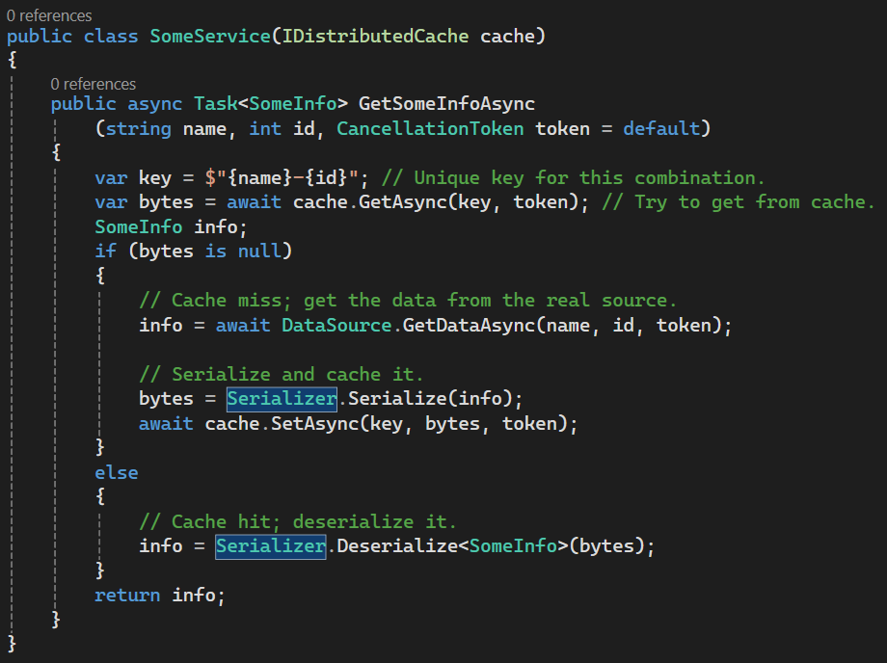
Problems with IDistributedCache
Verbose and complex
No serialization support
Inefficient byte[] allocations
Susceptible to cache stampede
Single caching tier

Slide 17
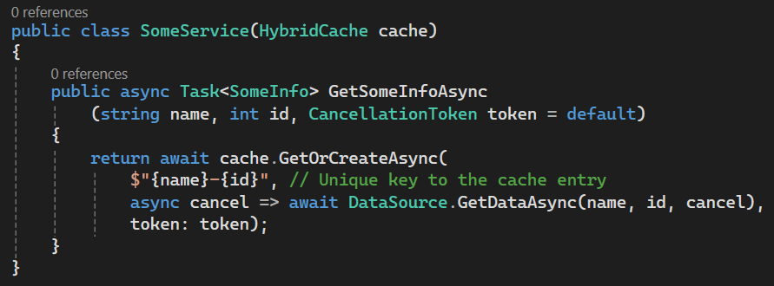
IDistributedCache ⇒ HybridCache
“Just works” for most cases
Enhanced features:
Built-in serialization
Stampede protection
L1/L2 (in-process/out-of-process) support
Efficient low-allocation API
Tagging and invalidation
And more!
More advanced options available when needed
Works with existing cache backends
Supports older .NET versions
Microsoft.Extensions.Cache.Hybrid

Slide 18
Other developer experience improvements
Trust the ASP.NET Core developer certificate on Linux
Endpoint metadata added to developer exception page
Improved Blazor WebAssembly & dictionary debugging

Slide 19
Demo
Developer experience

Slide 20




Optimized static web asset handling
Improvements to exception handling and debugging
Authentication enhancements
New Blazor Hybrid Templates
Improved Kestrel connection metrics
SignalR improved distributed tracing
Dictionary debugging improvements
ASP.NET Core in .NET 9
Built-in OpenAPI support
Detect Blazor component render mode
Up to 25% faster Blazor startup
Keyed service support in middleware
Improvements to DataProtection
SignalR AOT support
Blazor reconnection improvements
Trust Developer certs on Linux
API-ly Ever After: OpenAPI in .NET 9
Build hybrid apps with .NET MAUI
Introducing HybridCache in ASP.NET Core
More at .NET Conf 2024!

Slide 21

Get .NET 9
Download .NET 9 aka.ms/get-dotnet-9

Slide 22
Thank you

